Slide 1
e-learning Management system
Submitted By:
Rafi Ahmed
ID:UG02-47-18-030
Batch:47th
Submitted To:
Khan Md .Hasib
Lecturer ,State University of Bangladesh.

Slide 2
CONTENTS
Introduction
Home
About
Login
Home
Study
Overview

Slide 3
INTRODUCTION
This project that helps school/university/college students for their study.
Two sides of users ,the admin side and the student side.

Slide 4
Advantages Of eLearning:
We are able to link the various resources in several varying formats.
It is a very efficient way of delivering courses online.
Due to its convenience and flexibility, the resources are available from anywhere and at any time.
Everyone, who are part time students or are working full time, can take advantage of web-based learning.
Web-based learning promotes active and independent learning. 5.As we have access to the net 24x7, we can train ourself anytime and from anywhere also.

Slide 5
Software and tools
Tools:
A computer with a operating system(windows10)
Internet connection.
Software:
Internet browser (chorome,mozila,opera etc.)
Text editor(brackets)
Language:
HTML,CSS
Bootstrap
JavaScript. Database : Sql

Slide 6
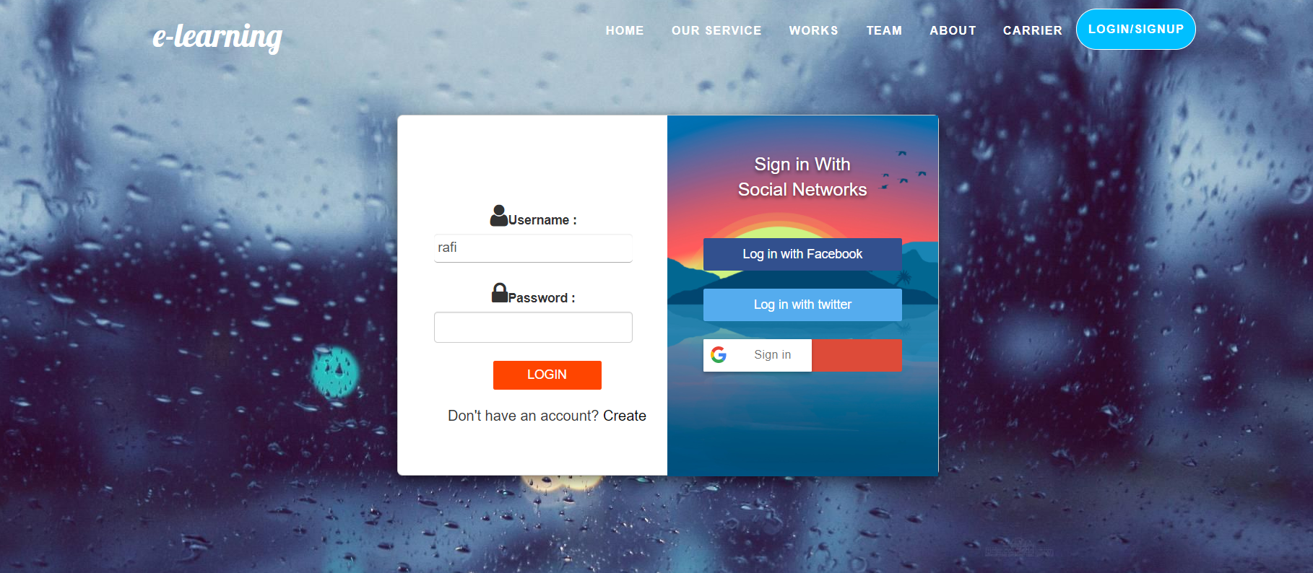
Login
This is the log in sector where one can log in their account.
It has 2 parts like log in,sign in.

Slide 7

HOME
One can find all kind of information here.
This is the main part of this project.

Slide 8
Future task
Making the website fully dynamic using MySQL database and Create individual student id in which they can add course like 10 minentes school.

Slide 9
Study
Here you can see all the information for study and book. If you want two read and take a cources.

Slide 10
About
This is the part of the author information.
One can see all the information about the author

Slide 11
OVERVIEW
I hope the e-learning manajment System in PHP will help us with what we’re looking for and hope that we’ll learn something with this project that is useful for our future projects.

Slide 12
Thank you

